Slide 1

Case Studies
Classic networks
deeplearning.ai

Slide 2

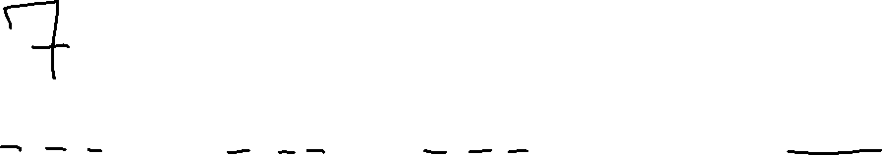






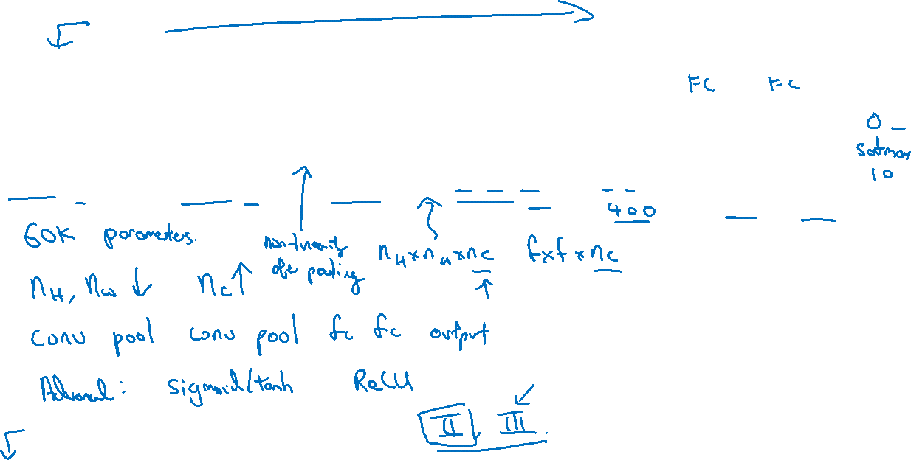
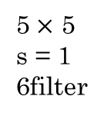


LeNet - 5
avg pool
avg pool
$$\hat{y}$$
5$×$ 5
s = 1
6filter
f = 2
s = 2
5$×$ 5
s = 1
16filter
f = 2
s = 2
$$⋮$$
$$⋮$$
32$×$32 $×$1
28$×$28$×$6
14$×$14$×$6
10$×$10$×$16
5$×$5$×$16
120
84
1、从输入到输出，nh、nw逐渐变小，nc逐渐变大
2、结构上，conv-pooling-conv-pooling-fc-fc-output。Fc：full connect
红字不是很重要，可以忽略
[LeCun et al., 1998. Gradient-based learning applied to document recognition]

Slide 3

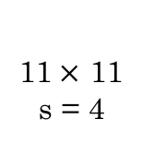
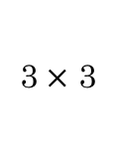

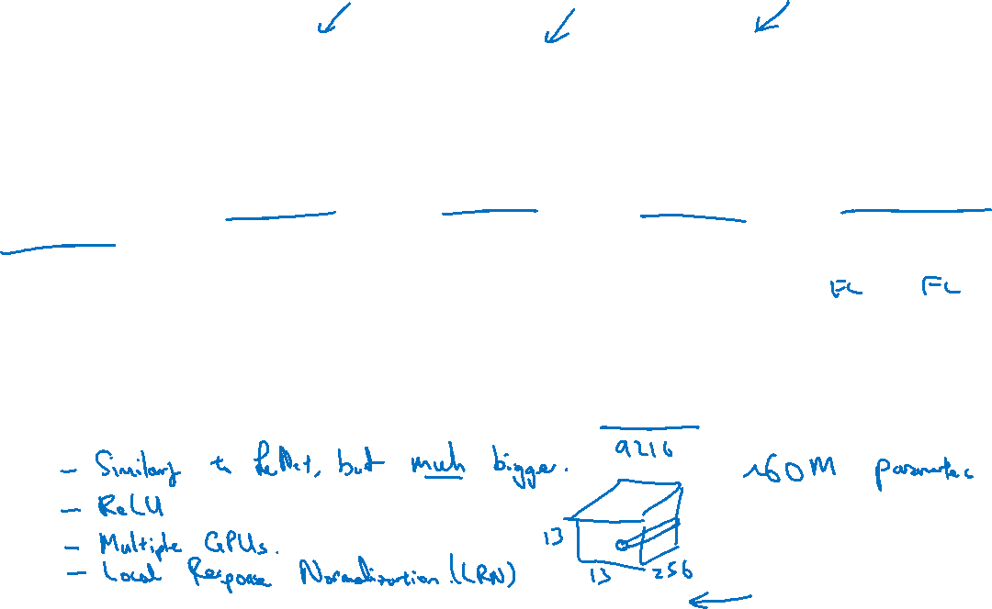

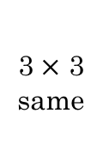

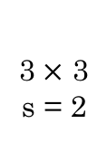



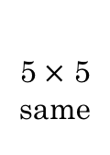

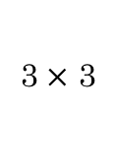


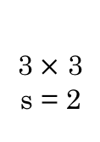
AlexNet
MAX-POOL
MAX-POOL
11$×$ 11
s = 4
3$×$ 3
s = 2
5$×$ 5
same
3$×$ 3
s = 2
55$×$55 $×9$6
27$×$27 $×$96
27$×$27 $×$256
13$×$13 $×$256
227$×$227 $×$3
MAX-POOL
=
3$×$ 3
same
3$×$ 3
3$×$ 3
3$×$ 3
s = 2
$$⋮$$
$$⋮$$
$$⋮$$
Softmax
1000
13$×$13 $×$384
13$×$13 $×$384
13$×$13 $×$256
6$×$6 $×$256
9216
4096
4096
[Krizhevsky et al., 2012. ImageNet classification with deep convolutional neural networks]

Slide 4
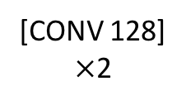


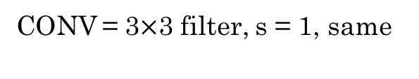
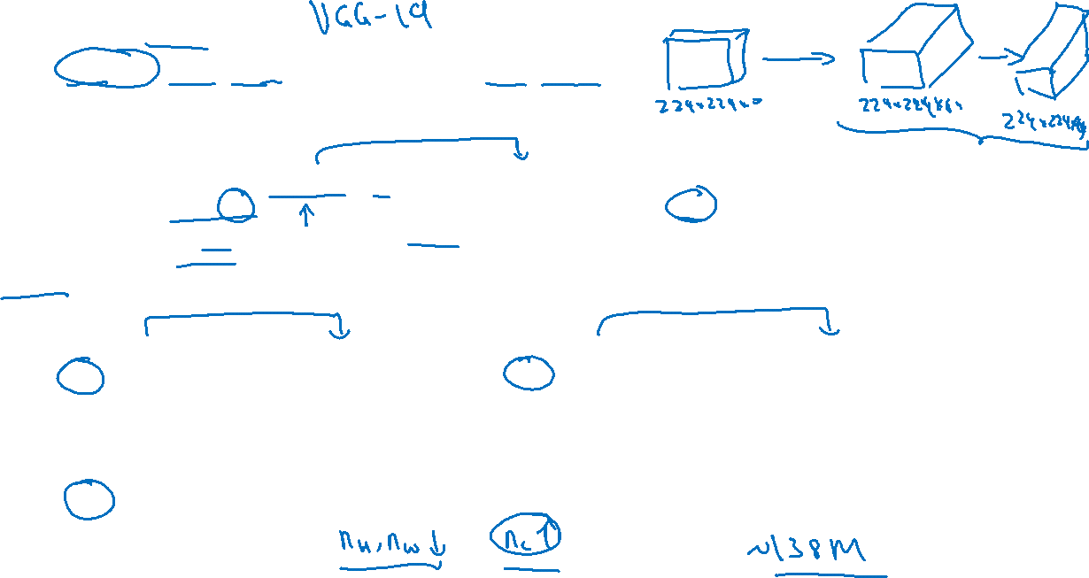


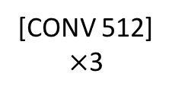



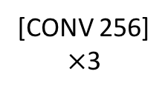
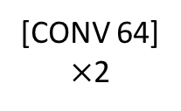



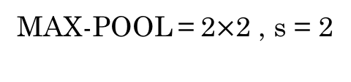

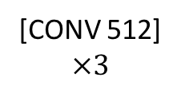
VGG - 16
CONV = 3$×$3 filter, s = 1, same
MAX-POOL = 2$×$2 , s = 2
224$×$224$×$64
112$×$112 $×$64
112$×$112 $×$128
56$×$56 $×$128
[CONV 64]
$×$2
POOL
[CONV 128]
$×$2
POOL
224$×$224 $×$3
56$×$56 $×$256
28$×$28 $×$256
28$×$28 $×$512
14$×$14$×$512
[CONV 256]
$×$3
POOL
[CONV 512]
$$×3$$
POOL
14$×$14 $×$512
7$×$7$×$512
FC
FC
Softmax
[CONV 512]
$×$3
POOL
4096
4096
1000
[Simonyan & Zisserman 2015. Very deep convolutional networks for large-scale image recognition]

